Slide 1
Software Quality Assurance
Lecture

Slide 2
Error, Bug, Fault & Failure
Error
It is a human action that produces the incorrect result that produces a fault.
Fault
State of software caused by an error.
Failure
Deviation of the software from its expected result. It is an event.
Bug
The presence of error at the time of execution of the software.

Slide 3
Why does software have errors?
When executing complex tasks, human beings do commit errors
This cannot be avoided
Experienced programmers commit 1 error in every 10 lines of code (average)
About 50% of these errors are corrected during code compilation
Further errors are corrected in testing
About 15% of the errors are still in the system when delivering it to the customer

Slide 4
Software Faults and Failures, Why Does Software Fail
Wrong requirement: not what the customer wants
Missing requirement
Requirement impossible to implement
Faulty design
Faulty code
Improperly implemented design

Slide 5
Quality
Traditional definition of quality:
fitness of purpose,
a quality product does exactly what the users want it to do.
Quality – Quality refers to any measurable characteristics such as correctness, maintainability, portability, testability, usability, reliability, efficiency, integrity, reusability and interoperability

Slide 6
Quality Terminologies
Quality of Design refers to the characteristics that designer’s specify for an item.
Quality of Conformance is the degree to which the design specifications are followed during manufacturing.
Quality Control is the series of inspections, reviews and tests used throughout the development cycle to ensure that each work product meets the requirements placed upon it.
Quality policy refers to the basic aims and objectives of an organization regarding quality as stipulated by the management.
Quality assurance consists of the auditing and reporting functions of management.
Cost of Quality includes all costs incurred in the pursuit of quality or in performing quality related activities such as appraisal costs, failure costs and external failure costs.
Quality planning is the process of assessing the requirements of the procedure and of the product and the context in which these must be observed.
Quality testing is assessment of the extent to which a test object meets given requirements
Quality assurance plan is the central aid for planning and checking the quality assurance.
Quality assurance system is the organizational structure, responsibilities, procedures, processes and resources for implementing quality management.

Slide 7
Software Product
Consider a software product:
functionally correct,
i.e. performs all functions as specified in the SRS document,
but has an almost unusable user interface.
cannot be considered as a quality product.

Slide 8
Software Product
Another example:
a product which does everything that users want.
but has an almost incomprehensible and unmaintainable code.

Slide 9
Quality
Definition of quality
“Degree of excellence, relative nature or kind of character, class or grade of thing as determined by this, general excellence"
(The New Oxford Illustrated Dictionary)

Slide 10
Quality
Software Quality is conformance to:
explicitly stated functional and performance requirements,
explicitly documented development standards,
implicit characteristics that are expected of all professionally developed software.
Developed product meet the its specification

Slide 11
Problems with Software Quality
Software specifications are usually incomplete and often inconsistent
There is tension between:
customer quality requirements (efficiency, reliability, etc.)
developer quality requirements (maintainability, reusability, etc.)
Some quality requirements are hard to specify in an unambiguous way
directly measurable qualities (e.g., errors/KLOC),
indirectly measurable qualities (e.g., usability).
Quality management is not just about reducing defects!

Slide 12
Quality
Quality Management – ensuring that required level of product quality is achieved
• Defining procedures and standards
• Applying procedures and standards to the product and process
• Checking that procedures are followed
• Collecting and analyzing various quality data
Problems:
• Intangible aspects of software quality can’t be standardized
(i.e elegance and readability)

Slide 13
Importance of Software Quality
Ariane 5 crash June 4, 1996
Maiden flight of the European Ariane 5 launcher crashed about 40 seconds after takeoff
Lost was about half a billion dollars
Explosion was the result of a software error
Uncaught exception due to floating-point error: conversion from a 64-bit integer to a 16-bit signed integer applied to a larger than expected number
Module was re-used without proper testing from Ariane 4
Error was not supposed to happen with Ariane 4
No exception handler

Slide 14
Importance of Software Quality
Several historic disasters attributed to software
First operational launch attempt of the space shuttle, whose real-time operating software consists of about 500,000 lines of code, failed
Synchronization problem among its flight-control computers
9 hour breakdown of AT&T's long-distance telephone network
Caused by an untested code patch

Slide 15
Relation of Software Engineering with SQA
Software engineering is the application of a systematic, disciplined, quantifiable approach to the development, operation and maintenance of software.
The characteristics of software engineering, especially its systematic, disciplined and quantitative approach, make software engineering a good environment for achieving SQA objectives.
It is commonly accepted that cooperation between software engineers and the SQA team is the way to achieve efficient and economic development and maintenance activities that, at the same time, assure the quality of the products of these activities.

Slide 16
Quality Attributes
...
Reliability
Software
Efficiency
Quality
Usability
Maintainability
Portability

Slide 17
Quality Attributes
product: delivered to the customer
process: produces the software product
Project: The actual act of executing the activities for some specific user need is a S/w project.
resources: (both the product and the process require resources)
Underlying assumption: a quality process leads to a quality product (cf. metaphor of manufacturing lines)

Slide 18
Quality Attributes
Correctness
A system is correct if it behaves according to its specification
An absolute property (i.e., a system cannot be “almost correct”)
... in theory and practice undecidable
Reliability
The user may rely on the system behaving properly
Reliability is the probability that the system will operate as expected over a specified interval
A relative property (a system has a mean time between failure of 3 weeks)
Robustness
A system is robust if it behaves reasonably even in circumstances that were not specified
A vague property (once you specify the abnormal circumstances they become part of the requirements)
Efficiency (Performance)
Use of resources such as computing time, memory
Affects user-friendliness and scalability

Slide 19
Quality Attributes
Usability (User Friendliness, Human Factors)
The degree to which the human users find the system (process) both “easy to use” and useful
Depends a lot on the target audience (novices vs. experts)
External product attributes
Maintainability
How easy it is to change a system after its initial release
Repairability, Evolvability , Portability
Internal product attributes
Verifiability
How easy it is to verify whether desired attributes are there?
internally: e.g., verify requirements, code inspections
Understandability
How easy it is to understand the system
internally: contributes to maintainability

Slide 20
External process attribute
Productivity
Amount of product produced by a process for a given number of resources
productivity among individuals varies a lot
Timeliness
Ability to deliver the product on time
important for marketing (“short time to market”)
Visibility (Transparency)
Current process steps and project status are accessible
important for management
also deal with staff turn-over
Function
User needs
System
capability
Time
t
0
t
1
t
2
t
3
t
4
initial
delivery
redesign

Slide 21
Quality Control Assumption
Project Concern = Deliver on time and within budget
External (and Internal)
Process Attributes
Product Attributes
Assumptions:
Internal quality
External quality
Process quality
Product quality
Control
during
project
Obtain
after
project
Otherwise, quality is mere coincidence!

Slide 22
Quality Plan
A quality plan should:
set out desired product qualities and how these are assessed
define the most significant quality attributes
define the quality assessment process
i.e., the controls used to ensure quality
set out which organizational standards should be applied
may define new standards, i.e., if new tools or methods are used

Slide 23
Software Quality Management System
Quality management system (or quality system):
principal methodology used by organizations to ensure that the products have desired quality.
Activities
Auditing of projects
Development of:
standards, procedures, and guidelines, etc.
Production of reports for the top management
summarizing the effectiveness of the quality system in the organization.
Review of the quality system itself.

Slide 24
Software Quality Assurance
Basic premise of modern quality assurance:
if an organization's processes are good and are followed rigorously,
the products are bound to be of good quality.
All modern quality paradigms include:
guidance for recognizing, defining, analyzing, and improving the production process.
SOFTWARE QUALITY ASSURANCE (SQA) is a set of activities for ensuring quality in software engineering processes (that ultimately result in quality of software products).

Slide 25
Software Testing

Slide 26
TESTING - INTRODUCTION
Checks for the validation of functional and non functional requirements.
Verifies that whether a given software product matching its SRS.
Validate the quality of a software testing using the minimum cost and efforts.
It is the process used to identify the correctness and completeness of developed computer software.
It is the process of executing a program/application under positive and negative conditions by manual or automated means.
Notes:
Discuss Testing phase in different life cycle models.

Slide 27
Objectives of Testing
Objective of testing: discover faults
A test is successful only when a fault is discovered
Fault identification is the process of determining what fault caused the failure
Fault correction is the process of making changes to the system so that the faults are removed

Slide 28
Test plan
Test Case
It is a systematic approach to test a system i.e. software.
The plan typically contains a detailed understanding of what the eventual testing workflow will be.
Test plan explains
who does the testing
why the tests are performed
how tests are conducted
when the tests are scheduled
Test Plan Contains
What the test objectives are
How the test will be run
What criteria will be used to determine when the testing is complete
It is a specific procedure of testing a particular requirement.
It is usually made for a specific use case.
It will include:
Identification of specific requirement
Test case success/failure criteria
Specific steps to execute test
Test input data
Expected and Actual result.

Slide 29
Test Case Format Test Case Example: Box Testing
TC id | Title | Input | Expected output | Actual Output | Status:
TC1 | addition of two numbers | X=10, y=11 | 21 | 21 | Pass
TC2 | subtraction of two numbers | a=10 b=7 | 3 | 17 | Fail

Slide 30
Test case examples
Test case | Scenario/Description | Steps | Expected Result | Actual result | Status
1 | As a User I should be able to add New Activity | 1- Open the app and navigate to add new category button. 2- click add new activity button | Showing the activity page | Showing the activity page | Pass
2 | As a User I should be able to specify date for my new added activity | 1- Open the add activity page by clicking the add new activity button 2- Browse to date button and enter date by using the pop up date picker | Date picker should popup to enter the date | Date picker should popup to enter the date | Pass
3 | As a User I should be able to see the activities that I have entered | 1- Click on the view activities button to see the previous activities. 2- Browse to see the activities by category | activities page should show activities by category | activities page is not showing activities by category | Fail

Slide 31
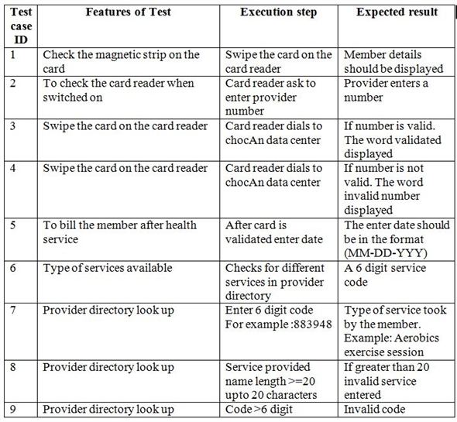

Slide 32
Testing Methodologies
White box testing
Black box testing

Slide 33

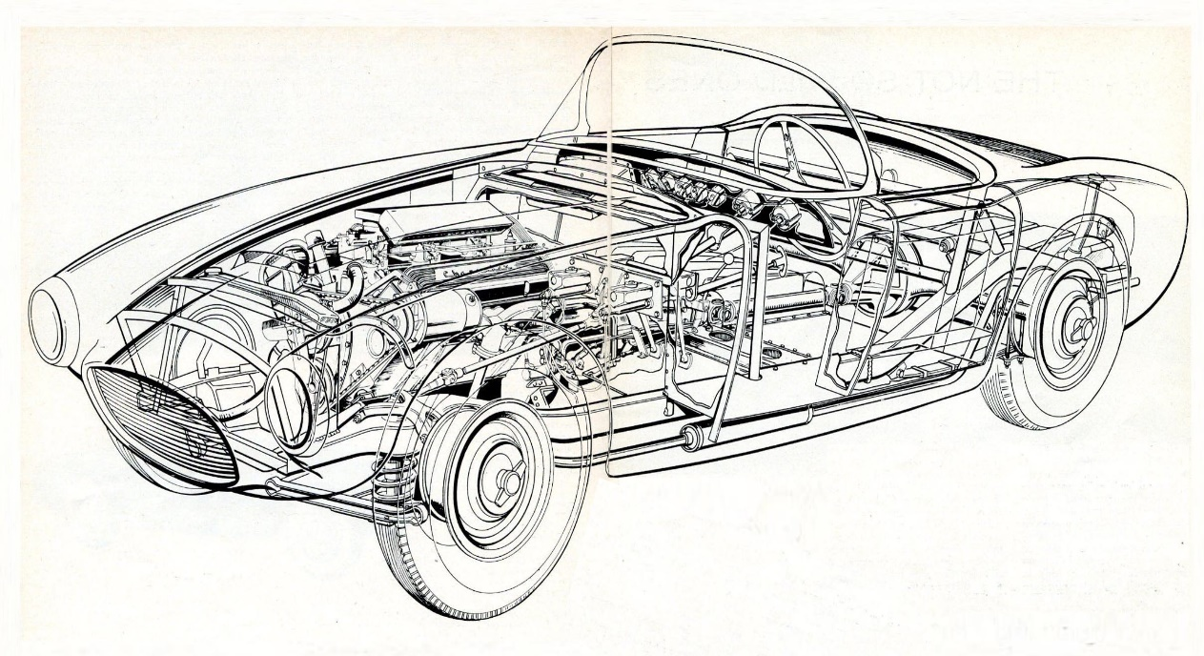
This is how a driver or user looks at me. I am opaque or black box for him.
Black Box vs White Box

Slide 34
White box testing
White Box Testing (also known as Clear Box Testing, Open Box Testing, Glass Box Testing, Transparent Box Testing, Code-Based Testing or Structural Testing) is a software testing method in which the internal structure/ design/ implementation of the item being tested is known to the tester.
White box testing is mainly used for detecting errors in the program code.
It can be applied at all levels of system development especially Unit and integration testing.

Slide 35
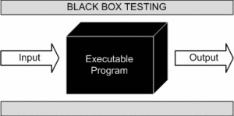
Black box testing
In Black Box Testing we just focus on inputs and output of the software system without bothering about internal knowledge of the software program.

Slide 36
Contd…
BLACK BOX TESTING, also known as Behavioral Testing
is a software testing method in which the internal structure/design/implementation of the item being tested is not known to the tester.
Tests are based on requirements written in SRS
Black-box testing is a method of software testing that examines the functionality of an application (e.g. what the software does)

Slide 37
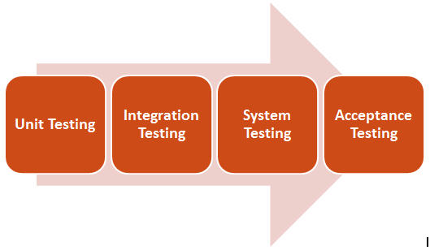
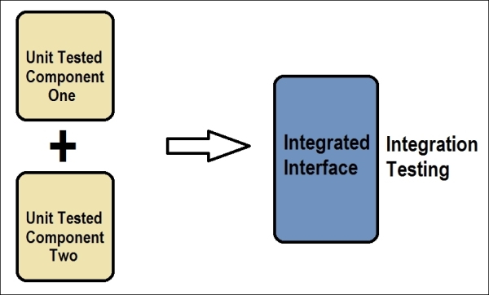
Levels of Testing
Unit Testing
Tests each module individually
Code walkthrough
Code inspection
Integration Testing
Once all the modules have been unit tested, integration testing is performed
System Testing
Verifies that all system elements work properly and that overall system function and performance has been achieved.
Acceptance Testing
It is performed by the customer to determine whether to accept or reject the delivery of the system.

Slide 38
System Testing and its types
In system testing the behavior of whole system/product is tested as defined by the scope of the development project or product.
System testing is most often the final test to verify that the system to be delivered meets the specification and its purpose.
System testing is carried out by specialists testers or independent testers.
Types of System Testing:
Function testing (GUI)
Performance Testing
Load testing
Usability testing
Volume testing
Stress Testing
Security Testing
Scalability testing
Compatibility testing
Smoke Testing
Regression Testing
Sanity testing
Installation testing
Ad Hoc Testing

Slide 39
Graphical User Interface Testing: To generate a set of test cases, test designers attempt to cover all the functionality of the system and fully exercise the GUI itself.
Performance Testing: It is testing that is performed, to determine how fast some aspect of a system performs under a particular workload.
Load Testing: It is a type of software testing which is conducted to understand the behavior of the application under a specific expected load. Load testing is performed to determine a system’s behavior under both normal and at peak conditions.
Usability Testing: In usability testing basically the testers tests the ease with which the user interfaces can be used. It tests that whether the application or the product built is user-friendly or not.
Volume Testing: Volume testing refers to testing a software application or the product with a certain amount of data. E.g., if we want to volume test our application with a specific database size, we need to expand our database to that size and then test the application’s performance on it.
Stress Testing: It involves testing beyond normal operational capacity, often to a breaking point, in order to observe the results
Notes:
Volume Testing = Large amounts of data Load Testing = Large amount of users Stress Testing = Too many users, too much data, too little time

Slide 40
Security Testing: Security testing is basically a type of software testing that’s done to check whether the application or the product is secured or not. It checks to see if the application is vulnerable to attacks, if anyone hack the system or login to the application without any authorization.
Scalability Testing: Testing the ability of a system, a network, or a process to continue to function well when it is changed in size or volume in order to meet a growing need.
Compatibility Testing: Compatibility testing is a type of software testing used to ensure compatibility of the system/application/website with various other objects such as other web browsers, hardware platforms, operating systems etc
Smoke Testing: Smoke Testing is a kind of Software Testing performed after software build to ascertain that the critical functionalities of the program are working fine. It is executed "before" any detailed functional or regression tests are executed on the software build. The purpose is to reject a badly broken application so that the QA team does not waste time installing and testing the software application.
Acceptance testing: Acceptance testing is basically done by the user or customer although other stakeholders may be involved as well. It enables customers and users to determine if the built system meets their needs and expectations.

Slide 41
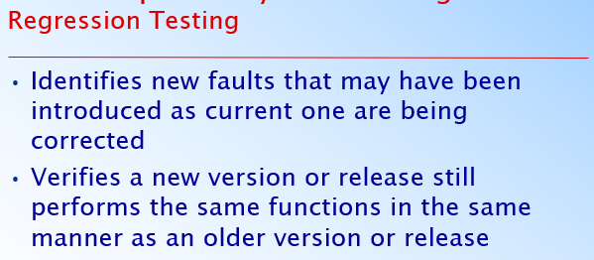
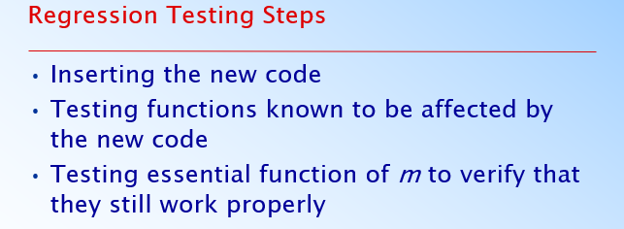

Slide 42
USE CASE BASED Testing
Test cases that exercise a system's functionalities from start to finish by testing each of it individual transactions.

Slide 43
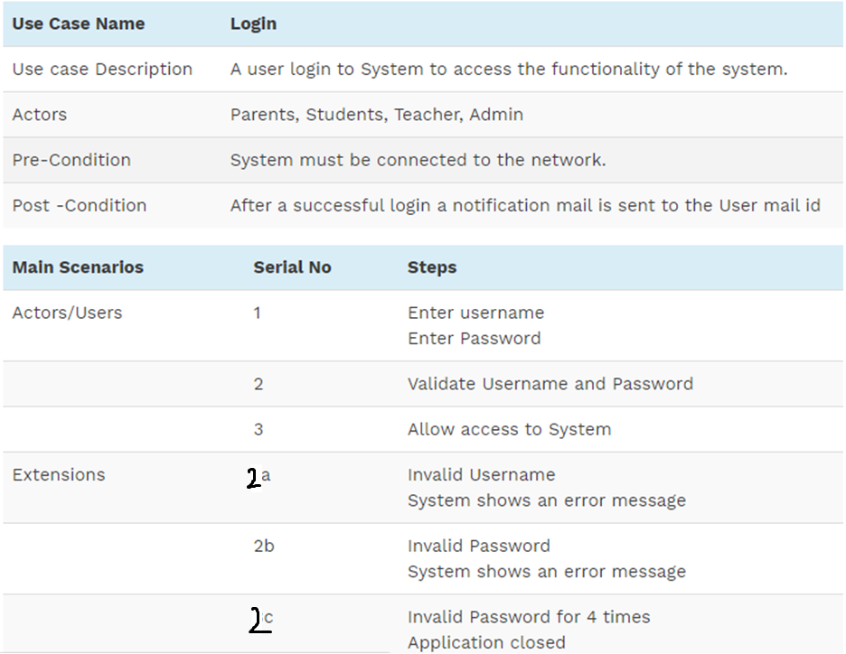

Slide 44
How to make a test case from use case.
use cases do not specify input data, the tester must select it.
To create test cases, start with normal data for the most often used transactions.
Then move to boundary values and invalid data.
Make sure you have at least one test case for every Extension in the use case.

Slide 45
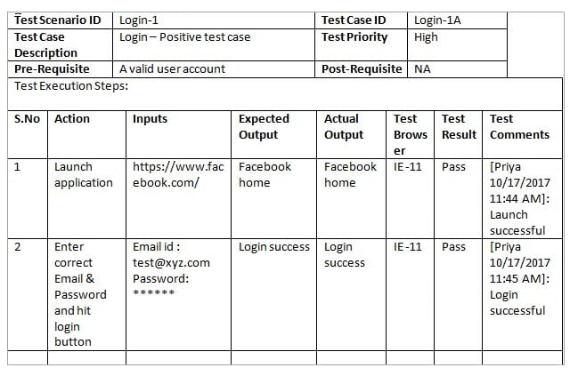

Slide 46
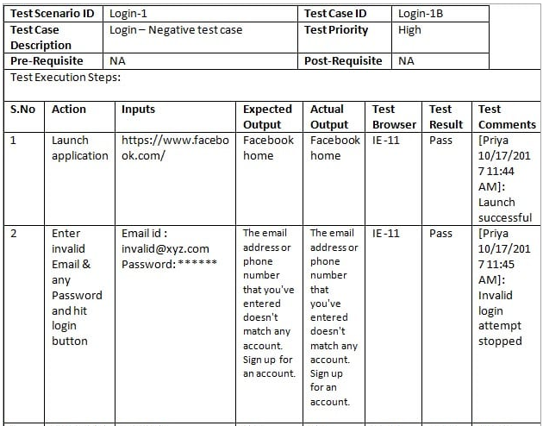

Slide 47
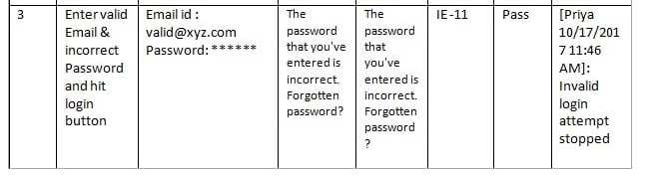

Slide 48
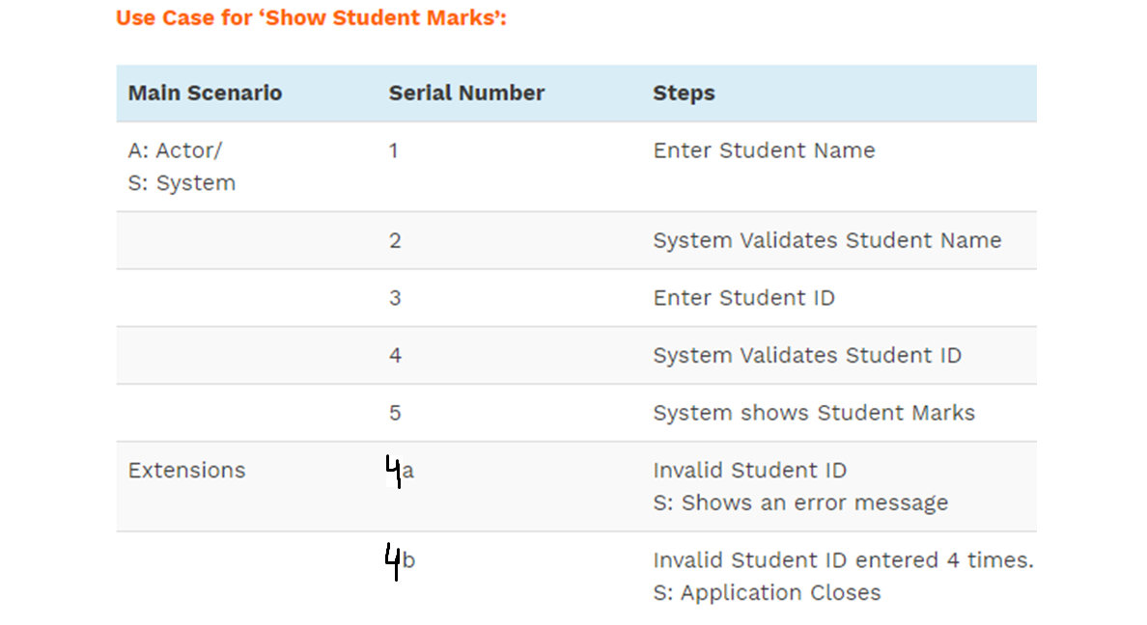

Slide 49
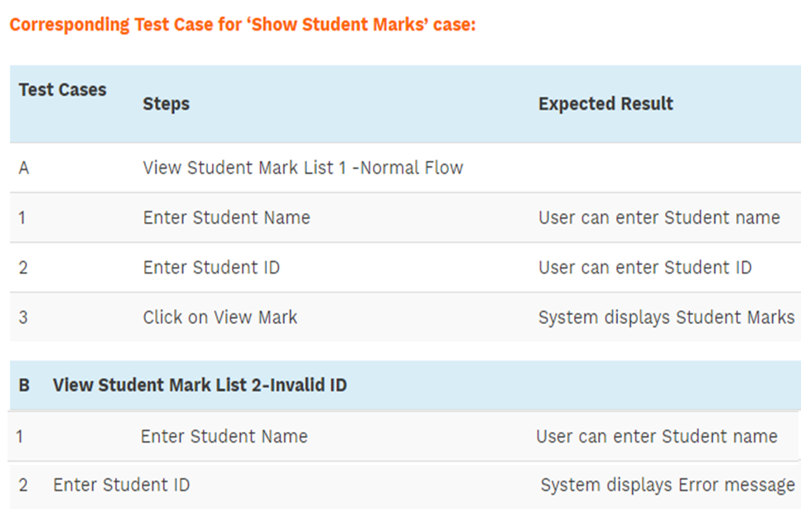

Slide 50
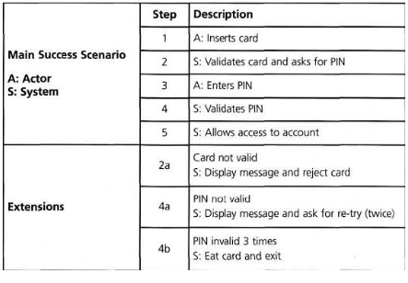

Slide 51
Identifier
Related requirements(s)
Short description
Pre-condition(s)
Input data
Detailed steps
Expected result(s)
Post-condition(s)
Actual result(s)
Test Case Result | Pass

